Slide 1

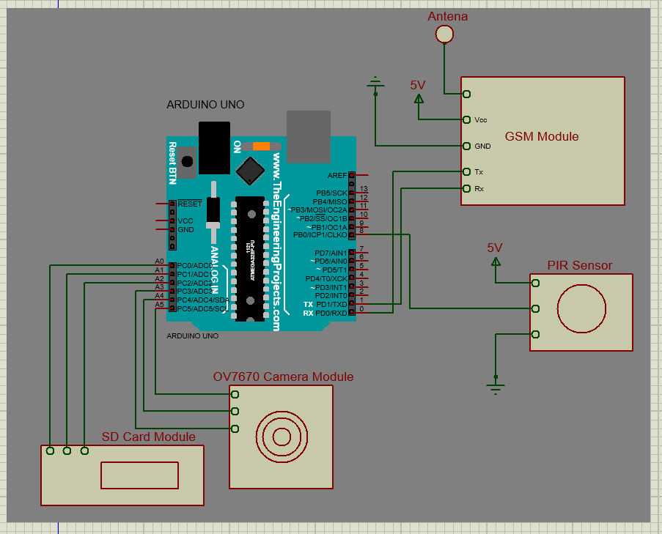
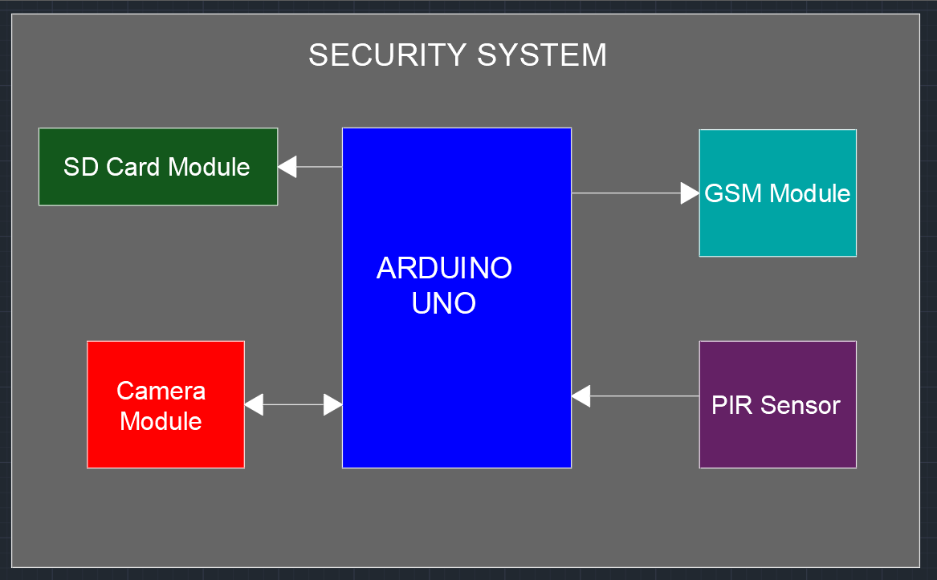
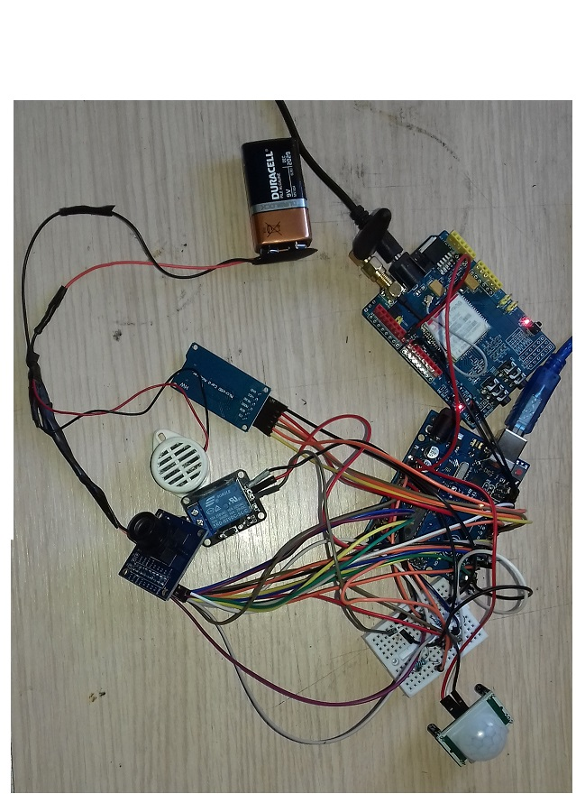
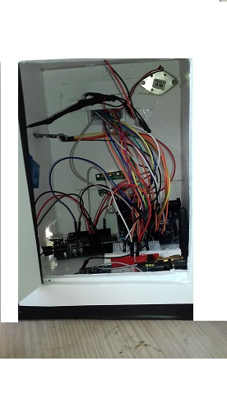
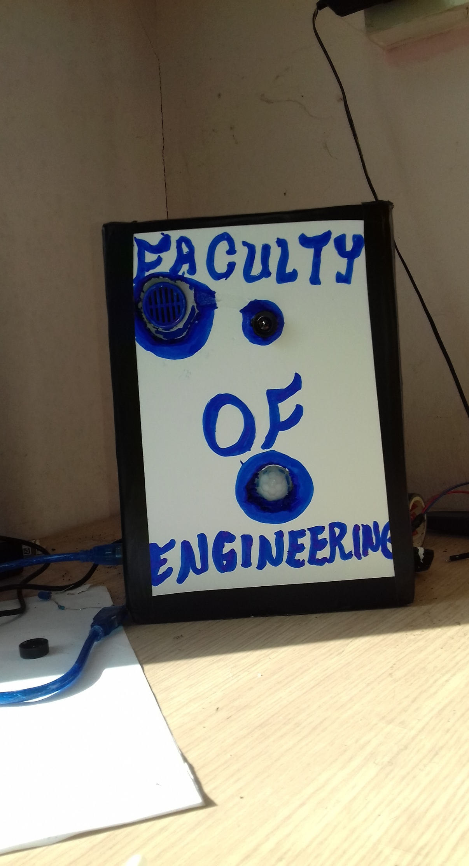
SECURITY SYSTEM
ADVISOR NAME: ASST. PROF. DR. BURCIN ÖZMEN
STUDENT NAME: BAKARY BADJIE
STUDENT NUMBER: 154354 European University of Lefke, Engineering Faculty, Lefke, T.R.N.C
Introduction
Conclusions
Innovative technologies are being developed by people to improve the quality of human lives in this age, and all are using technological advances in many ways. In golden days, people secure their homes and other places by using the locks and keys. A due unsecured environment, such system can be easily be broken and owners are aware of it. Today in the modern world, the security measures are a very important factor regarding its safety. Therefore, the security level has moved on to the next level where all the control regarding the lies is regulated by the Owners hand. Researchers have been conducted regarding the automated and security of the homes and other facilities. One of the main developed systems is Home Security System, which is a most superior protective device in the recent world. It is a paramount home security, which provides affordable, genuine and effective at the same time in this fast moving competitive world. In this modern developed network society, each individual can access their information easily anytime from anywhere. On the other, they can face the risk that others can also hack into their personal and their sensitive information. Due to this risk personal identification technology can differentiate between authorized and imposters, which is now generating great interest among users. Generally, for the sake of purposes, various security measures like PIN verification, identification card techniques are being used but currently, it can be mishandled and hacked. Due to the difficulty faced by the current home-based security and surveillance, systems in providing information to the situation while the users being away from home. This paper we have discussed and tried to overcome this project which provides implementation of different features in the home security along with control of home automation using mobile and also provide user to add extra devices that provide them to keep track and record of intruder and direct alert message to corresponding following secure medium to ensure the very first safety towards environment. This article talks on the hardware and software design, the implementation, and working of individual components and the overall functioning with a conclusion and its future work.
Results
This report has presented the theoretical and practical design of a security system. These described the design and construction of the system in such a way that maintenance and repairs can be easily carryout in terms of faults. The design of this system involves research in different aspects of physics and electronic technology; this includes telecommunication, networking, cellular communications, computer programming, software engineering, wireless communication, microprocessor theory, theory of electromagnetic wave propagations, and introduction to mobile communication, signal and system, Digital Image Processing etc.
The project is now practically designed to provide security for homes, banks, hospital, prisons, supermarkets, military barracks, safe houses and other restricted installations by sending a text message to the concerned persons via his or her mobile phone, in order to be alerted on intrusion situations. Today almost everyone is using mobile phone so by the use of this system, users will not have to carry additional device to monitor their homes and other places. In this project, the PIR sensor served as a movement detector, the Arduino board microcontroller as a signal-processing component, the SIM900 GSM module as a text-messaging device, the OV7670 camera module served as an image-capturing component and the SD card module as a data storage device.
In event of risk of intruders or vandalism from domestic properties, restricted installations, private places, commercial places, this project counter-act these situations by making a quick alert to the concerned persons. The overall developments of this project is a basic solution for the growing security concern.
Circuit diagram and block diagram of the system
The implemented system
Methods & Materials
References
The method of implementing this system involves the following steps:
Interfacing the Passive Infrared (PIR) sensor with the Ardduino UNO in which the Arduino received logical signals from the PIR sensor whenever motion is detected.
Interfacing the Arduino with the SIM900 GSM module in which the GSM module receive serial data from the serial outputs of the Arduino through its serial inputs with help of serial commands. This processing enable the GSM module to send text message whenever motion is detected by the sensor .
Interfacing the Arduino with the OV7670 camera module in which the Arduino command the camera to capture any movements detected by the PIR sensor, in return, the camera module send back the captured signals back to the Arduino.
Interfacing the SD card module with the Arduino in which the Arduino stored the Capture images by the camera in the SD card.
Materials used for this system are as follows:
Passive infrared (PIR) motion sensor
Arduino UNO
SIM900A GSM Module
OV7670 camera module
SD card Module
Three 10k resistors
Arduino synchronize cable
Jumper cables (male and female)
[1]Chowdhury ZI, Imtiaz MH, Azam MM, Sumi MR, Nur NS. Design and implementation of pyroelectric infrared sensor based security system using microcontroller. In Students' Technology Symposium (TechSym), 2011 IEEE 2011 Jan 14 (pp. 1-5). IEEE.
[2]Dhake PS, Borde SS. Embedded Surveillance System Using PIR Sensor. International Journal of Advanced Technology in Engineering and Science. 2014 Mar; 2 (3).
[3] Akaiwa, Y. (2008) Introduction to Digital mobile communication, 2nd Edition. ISBN: 978-1-119-04110-8 (June 12, 2016) [Online]
[4] Michel. M and Bernadette. P (2002) GSM system for mobile communication 2nd Edition.
[6] Massimo B. (2008) Getting Started with Arduino 1st Edition
Acknowledgements
First, I want to thank Almighty Allah for allowing me to reach at this stage in my academic career.
I owe special debt of gratitude to Professor Dr. Sadik Ülker my course advisor who is also the dean of faculty of engineering, Assistant professor Dr. Burçın Özmen head of the department of electrical and electronic engineering, who is also my project supervisor, for their constant support and guidance throughout the course of this report in all aspects. Their sincerity, thoroughness, and perseverance have been a constant source of inspiration for me. It is only their cognizant efforts that my endeavours have seen the light of the day.
I also do not want to miss this opportunity to acknowledge the contribution of all the staffs of the department of electrical and electronic engineering for their endless support, excellent and an understandable academic delivery from day one of my studies in the European University of Lefke up to date. I also owe a debt of gratitude to my family for their continuous prayers and that my employee the Gambia National Army for having confidence in me for funding my entire studies and my stay in North Cyprus.

